Slide 1
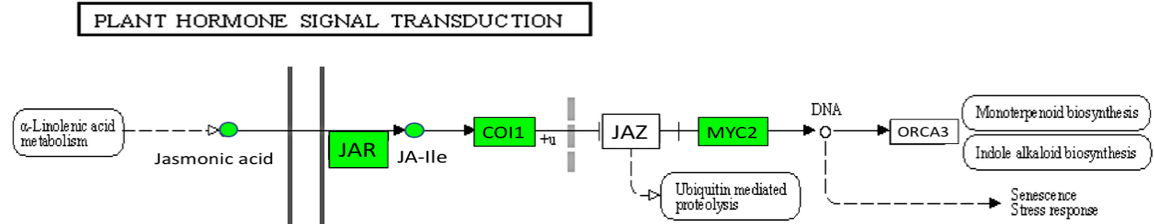

Slide 2
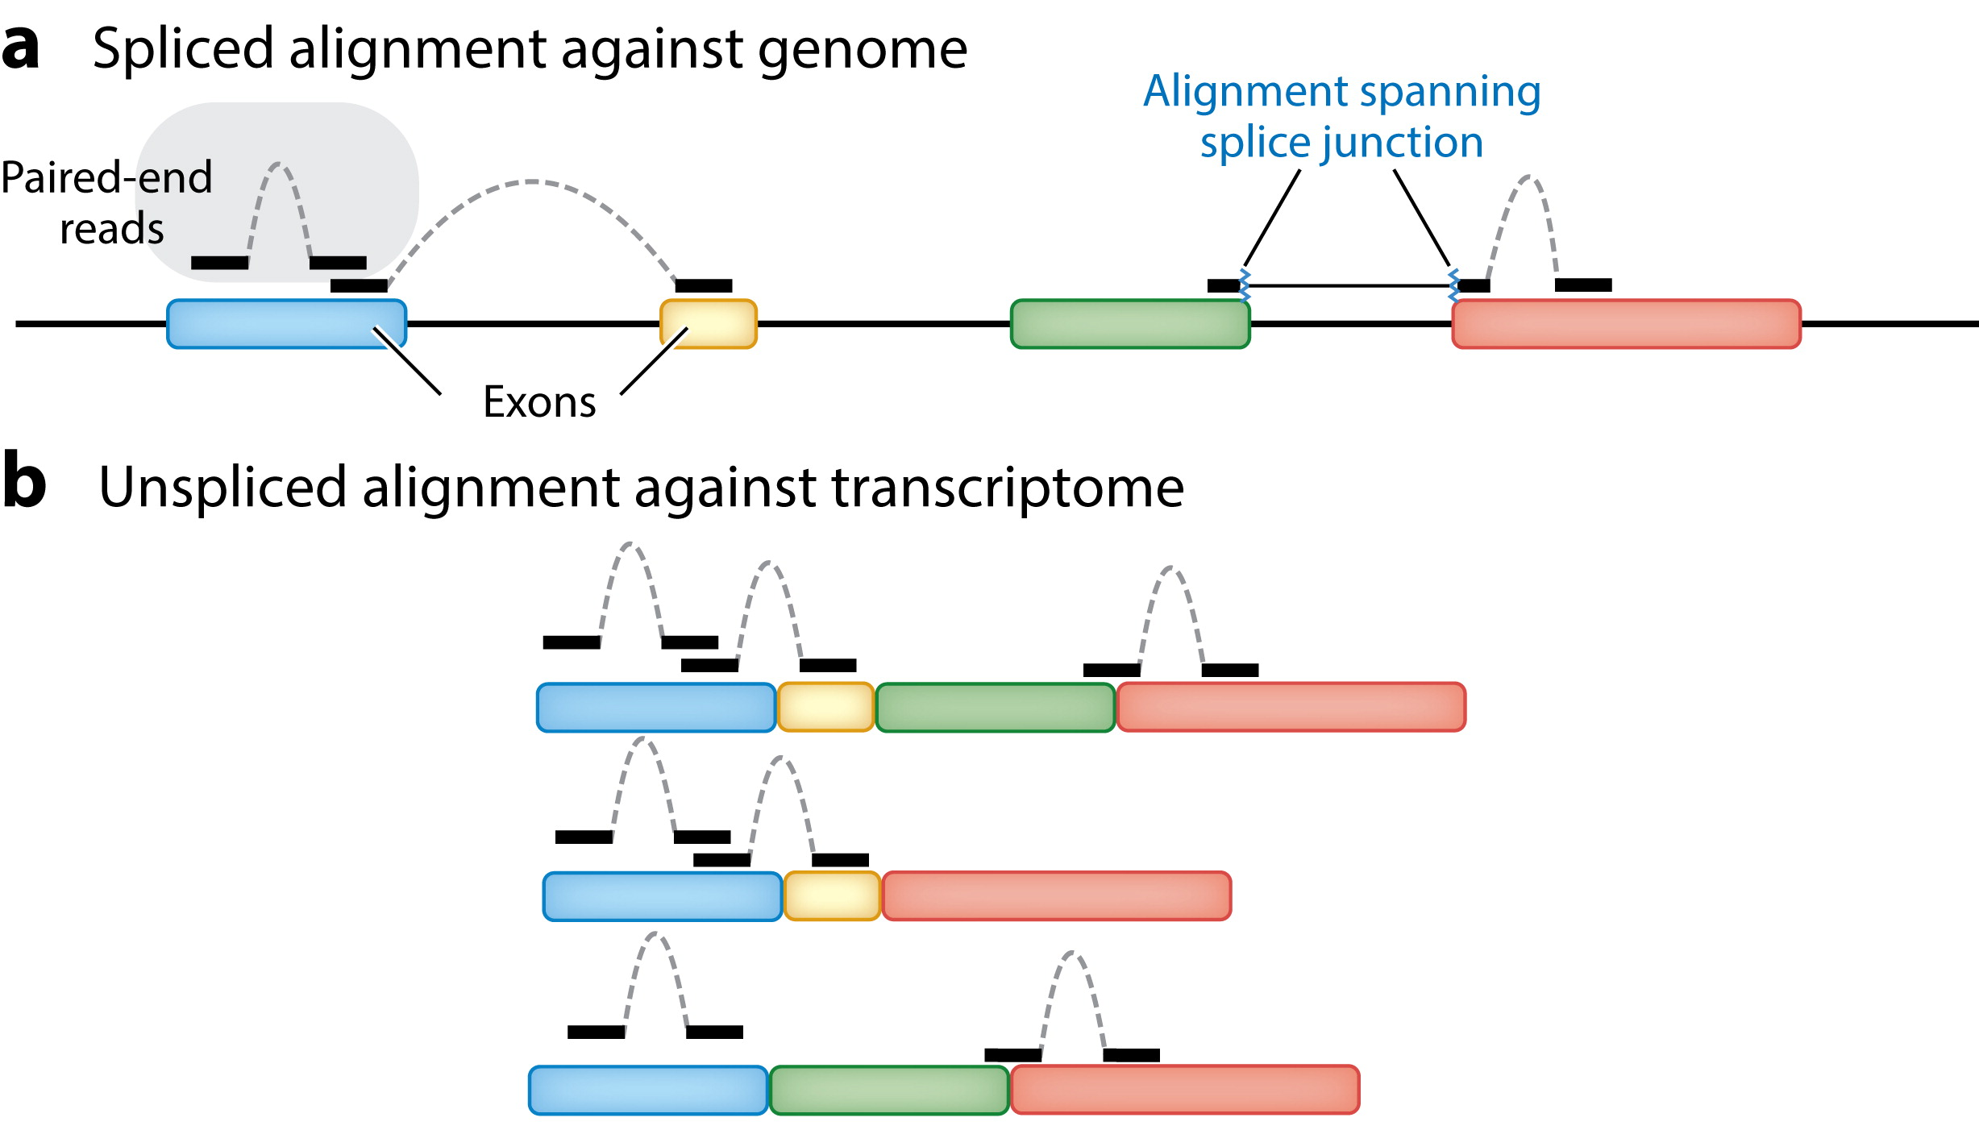

Slide 4
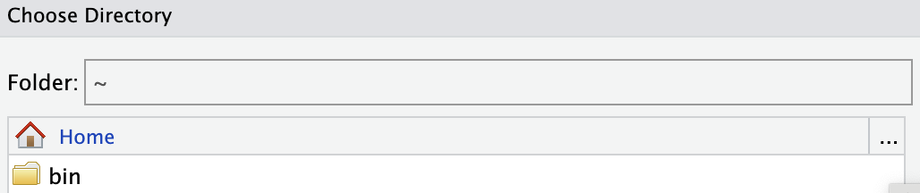

Slide 5
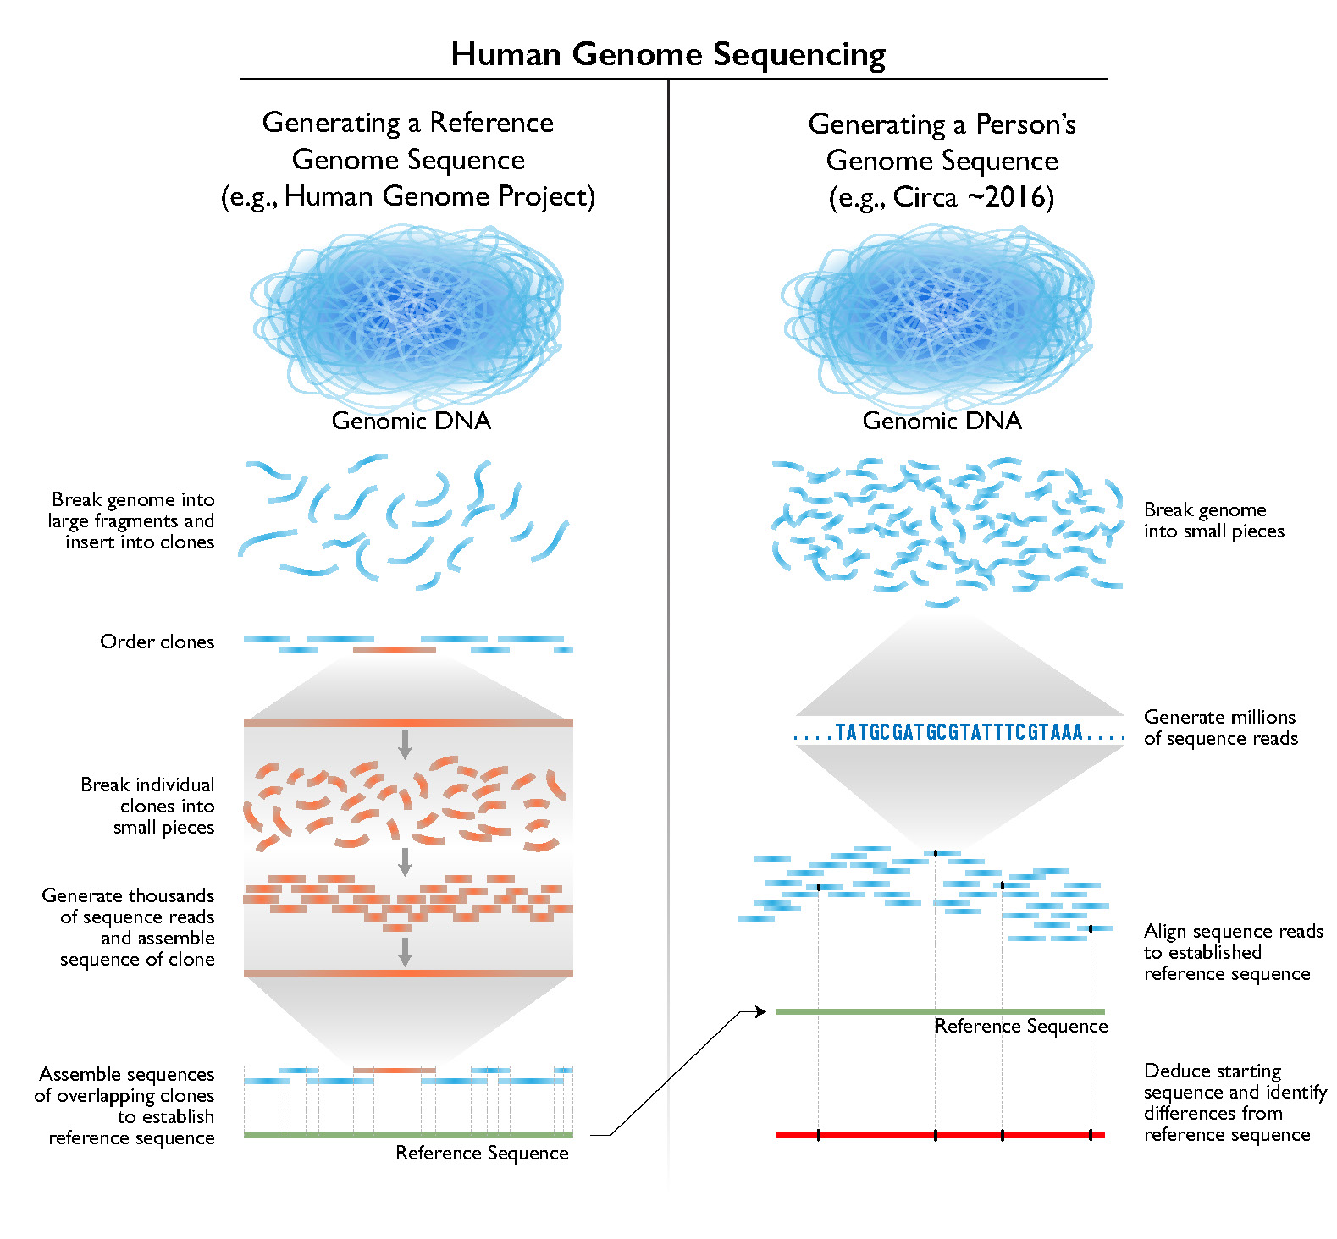

Slide 6
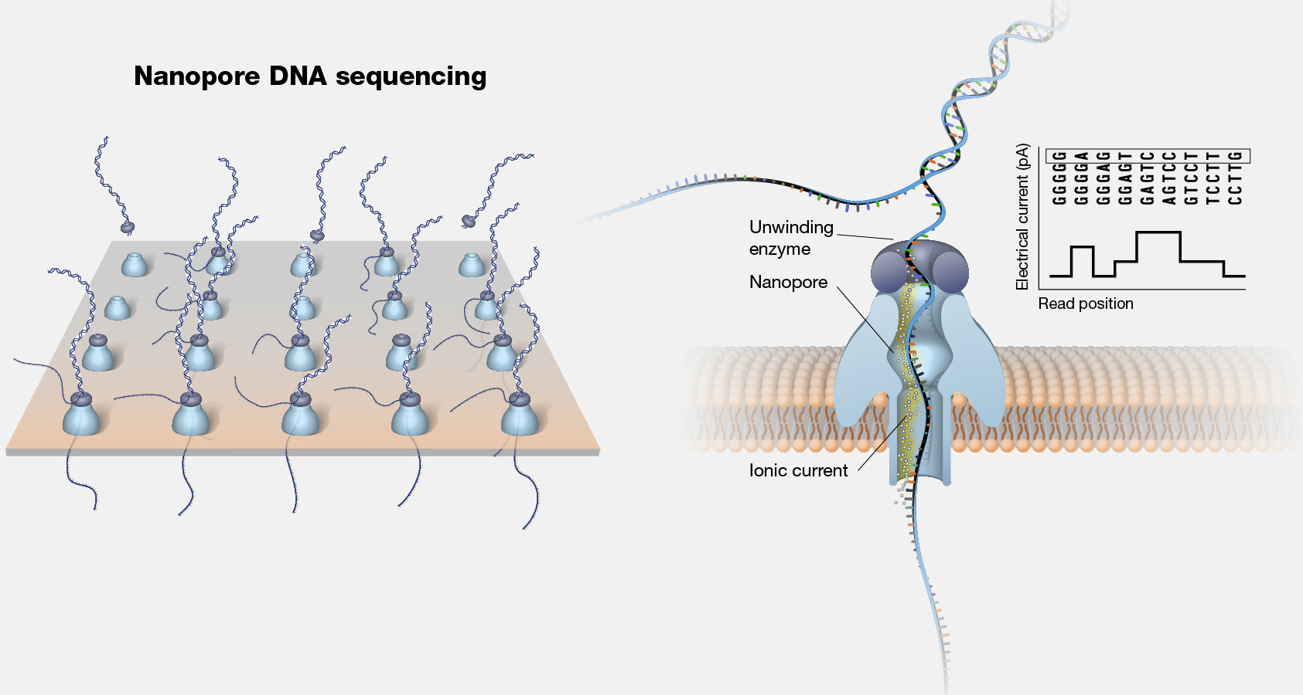

Slide 7
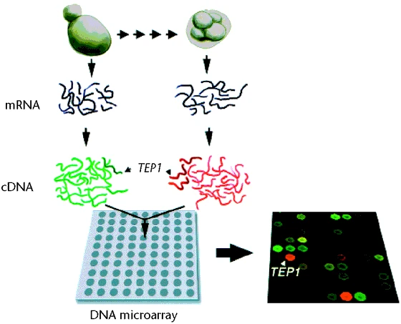

Slide 8
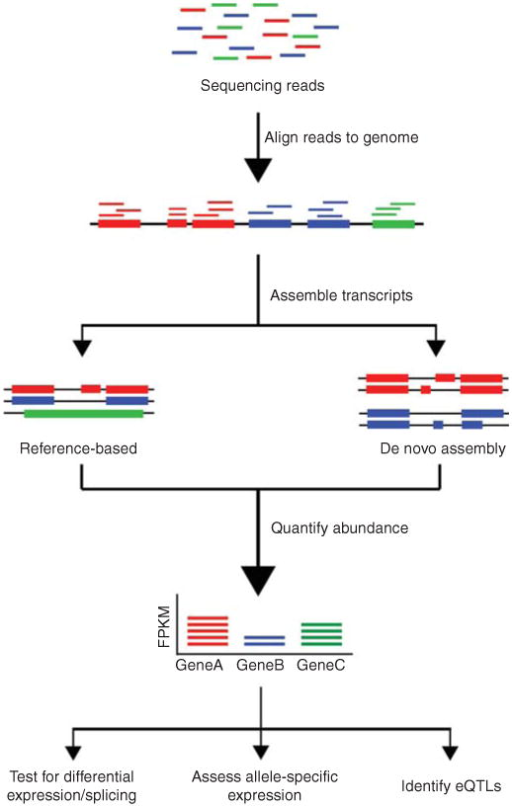

Slide 9

genome
transcriptome
proteome

Slide 10
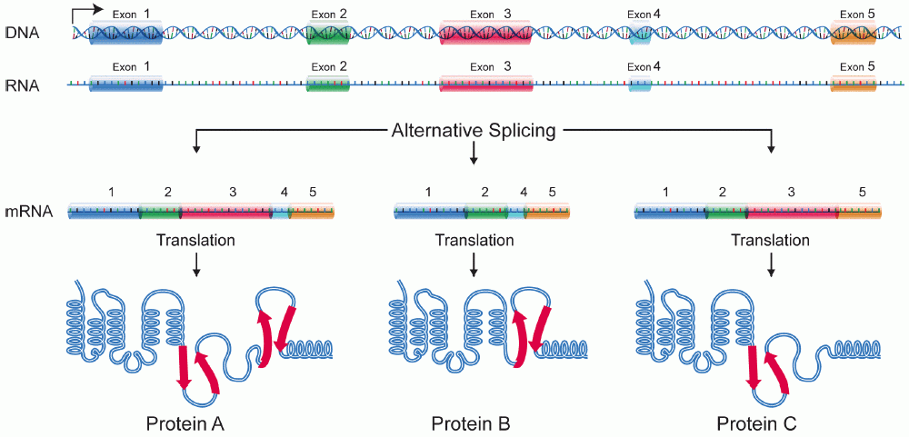
Transcription

Slide 11
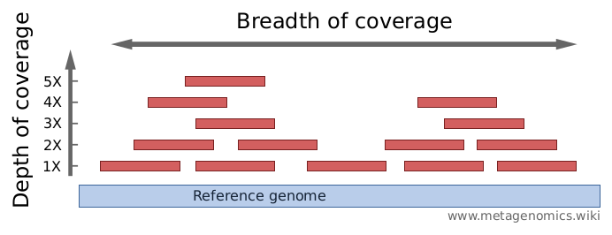

Slide 12
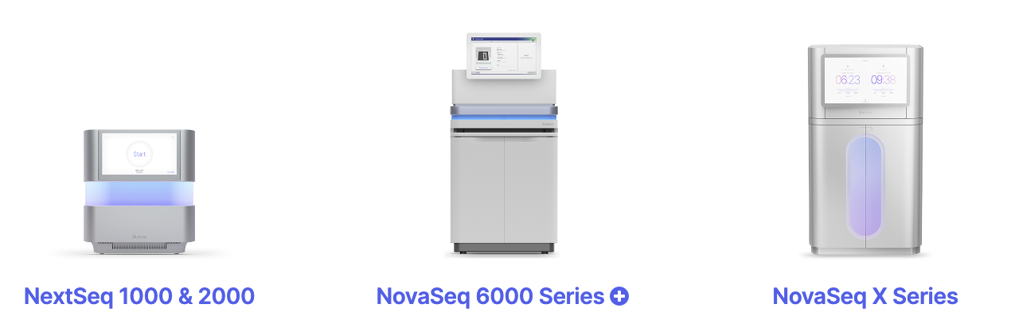
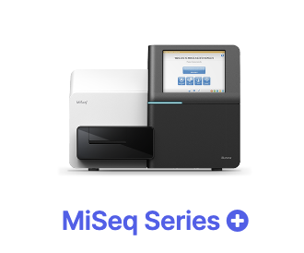
Max. output 15 Gb 360 Gb 6000 Gb 16 Tb
Max. # reads 25 M 1.2 B 20 B 52 B
Max. read length 300 bp 300 bp 250 bp 150 bp
Price per Gb $100-$200 $17-$60 $5-$30 $2-$3

Slide 13
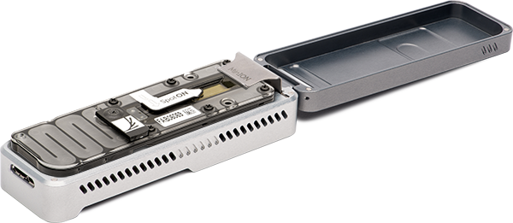
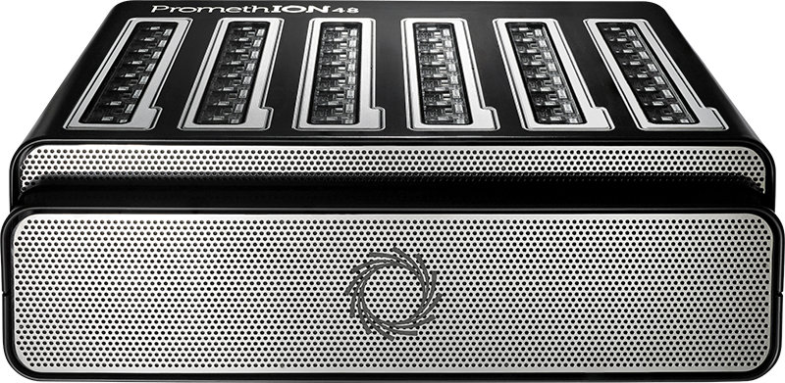
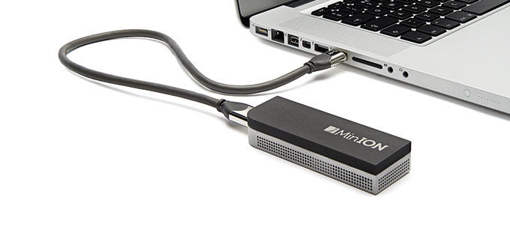
MinION ~15 Gb
PromethION ~90 Gb x 24/48 flowcells

Slide 14
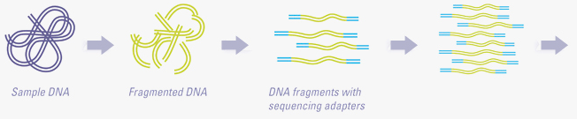
DNA fragmentation
Adapter addition
PCR enrichment
To sequencer

Slide 15
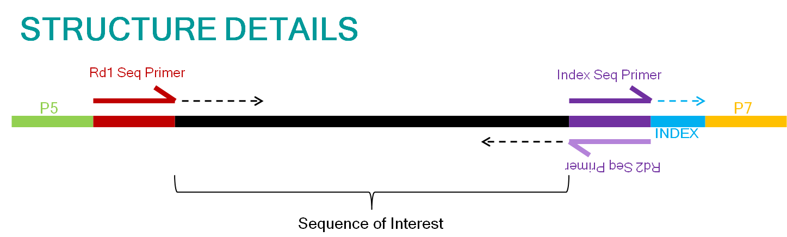
Adapter 1
DNA fragment
Adapter 2

Slide 16
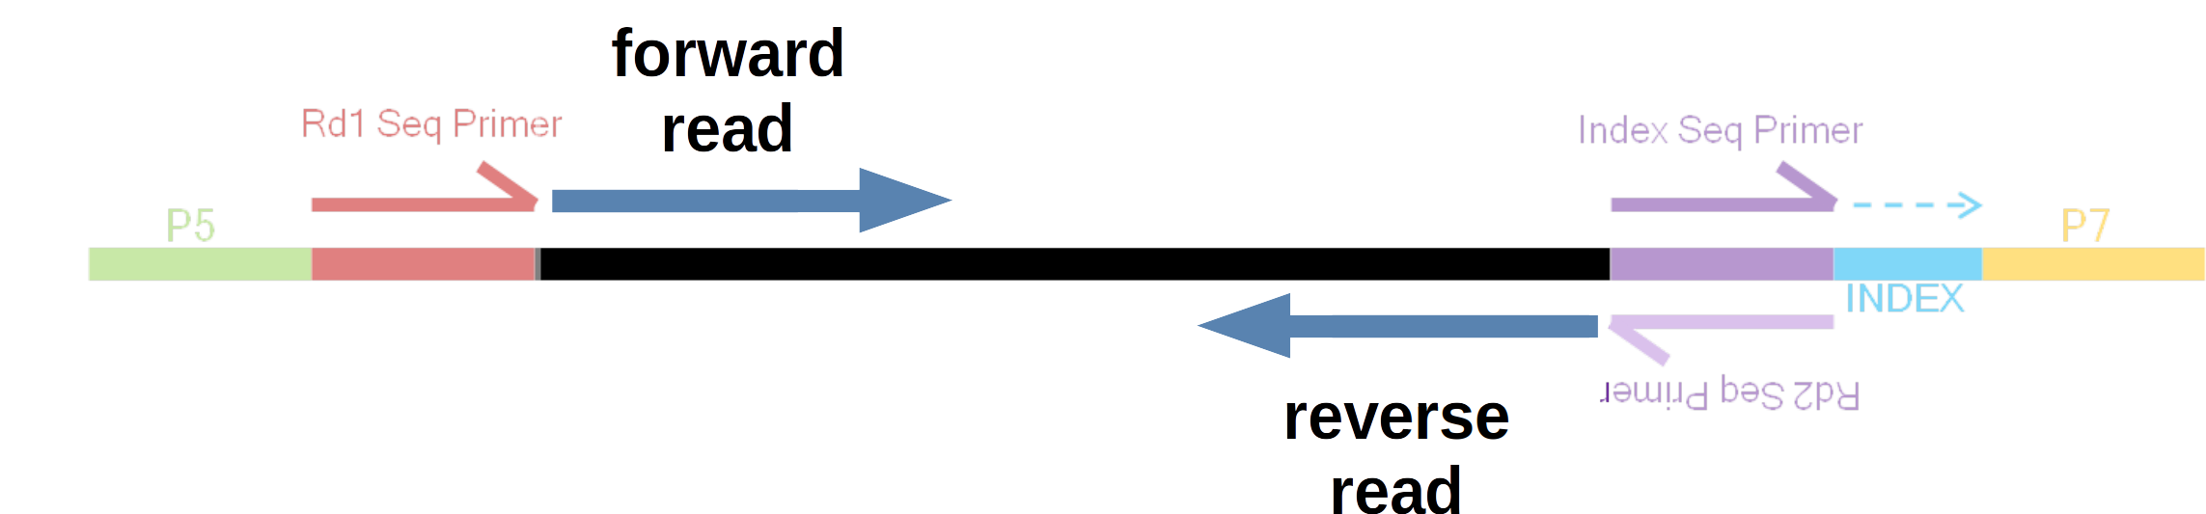
Adapter 1
DNA fragment
Adapter 2

Slide 17
forward read
reverse read
forward read
forward read
reverse read

Slide 18
forward read
reverse read
150 bp
100 bp
150 bp
Insert size: 400 bp
forward read
reverse read

Slide 19
forward read
reverse read

Slide 20
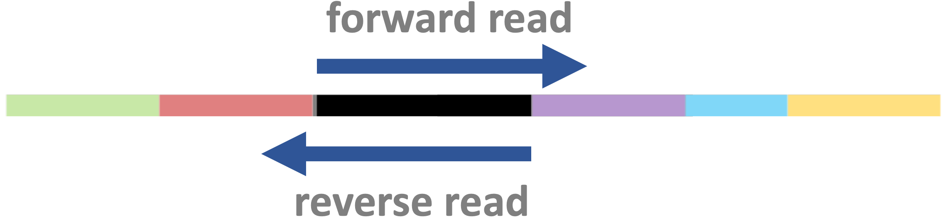


Slide 22
Indicate synthesis start site using sequencing primers
Binding to the flowcell
PCR amplification of fragments

Slide 23
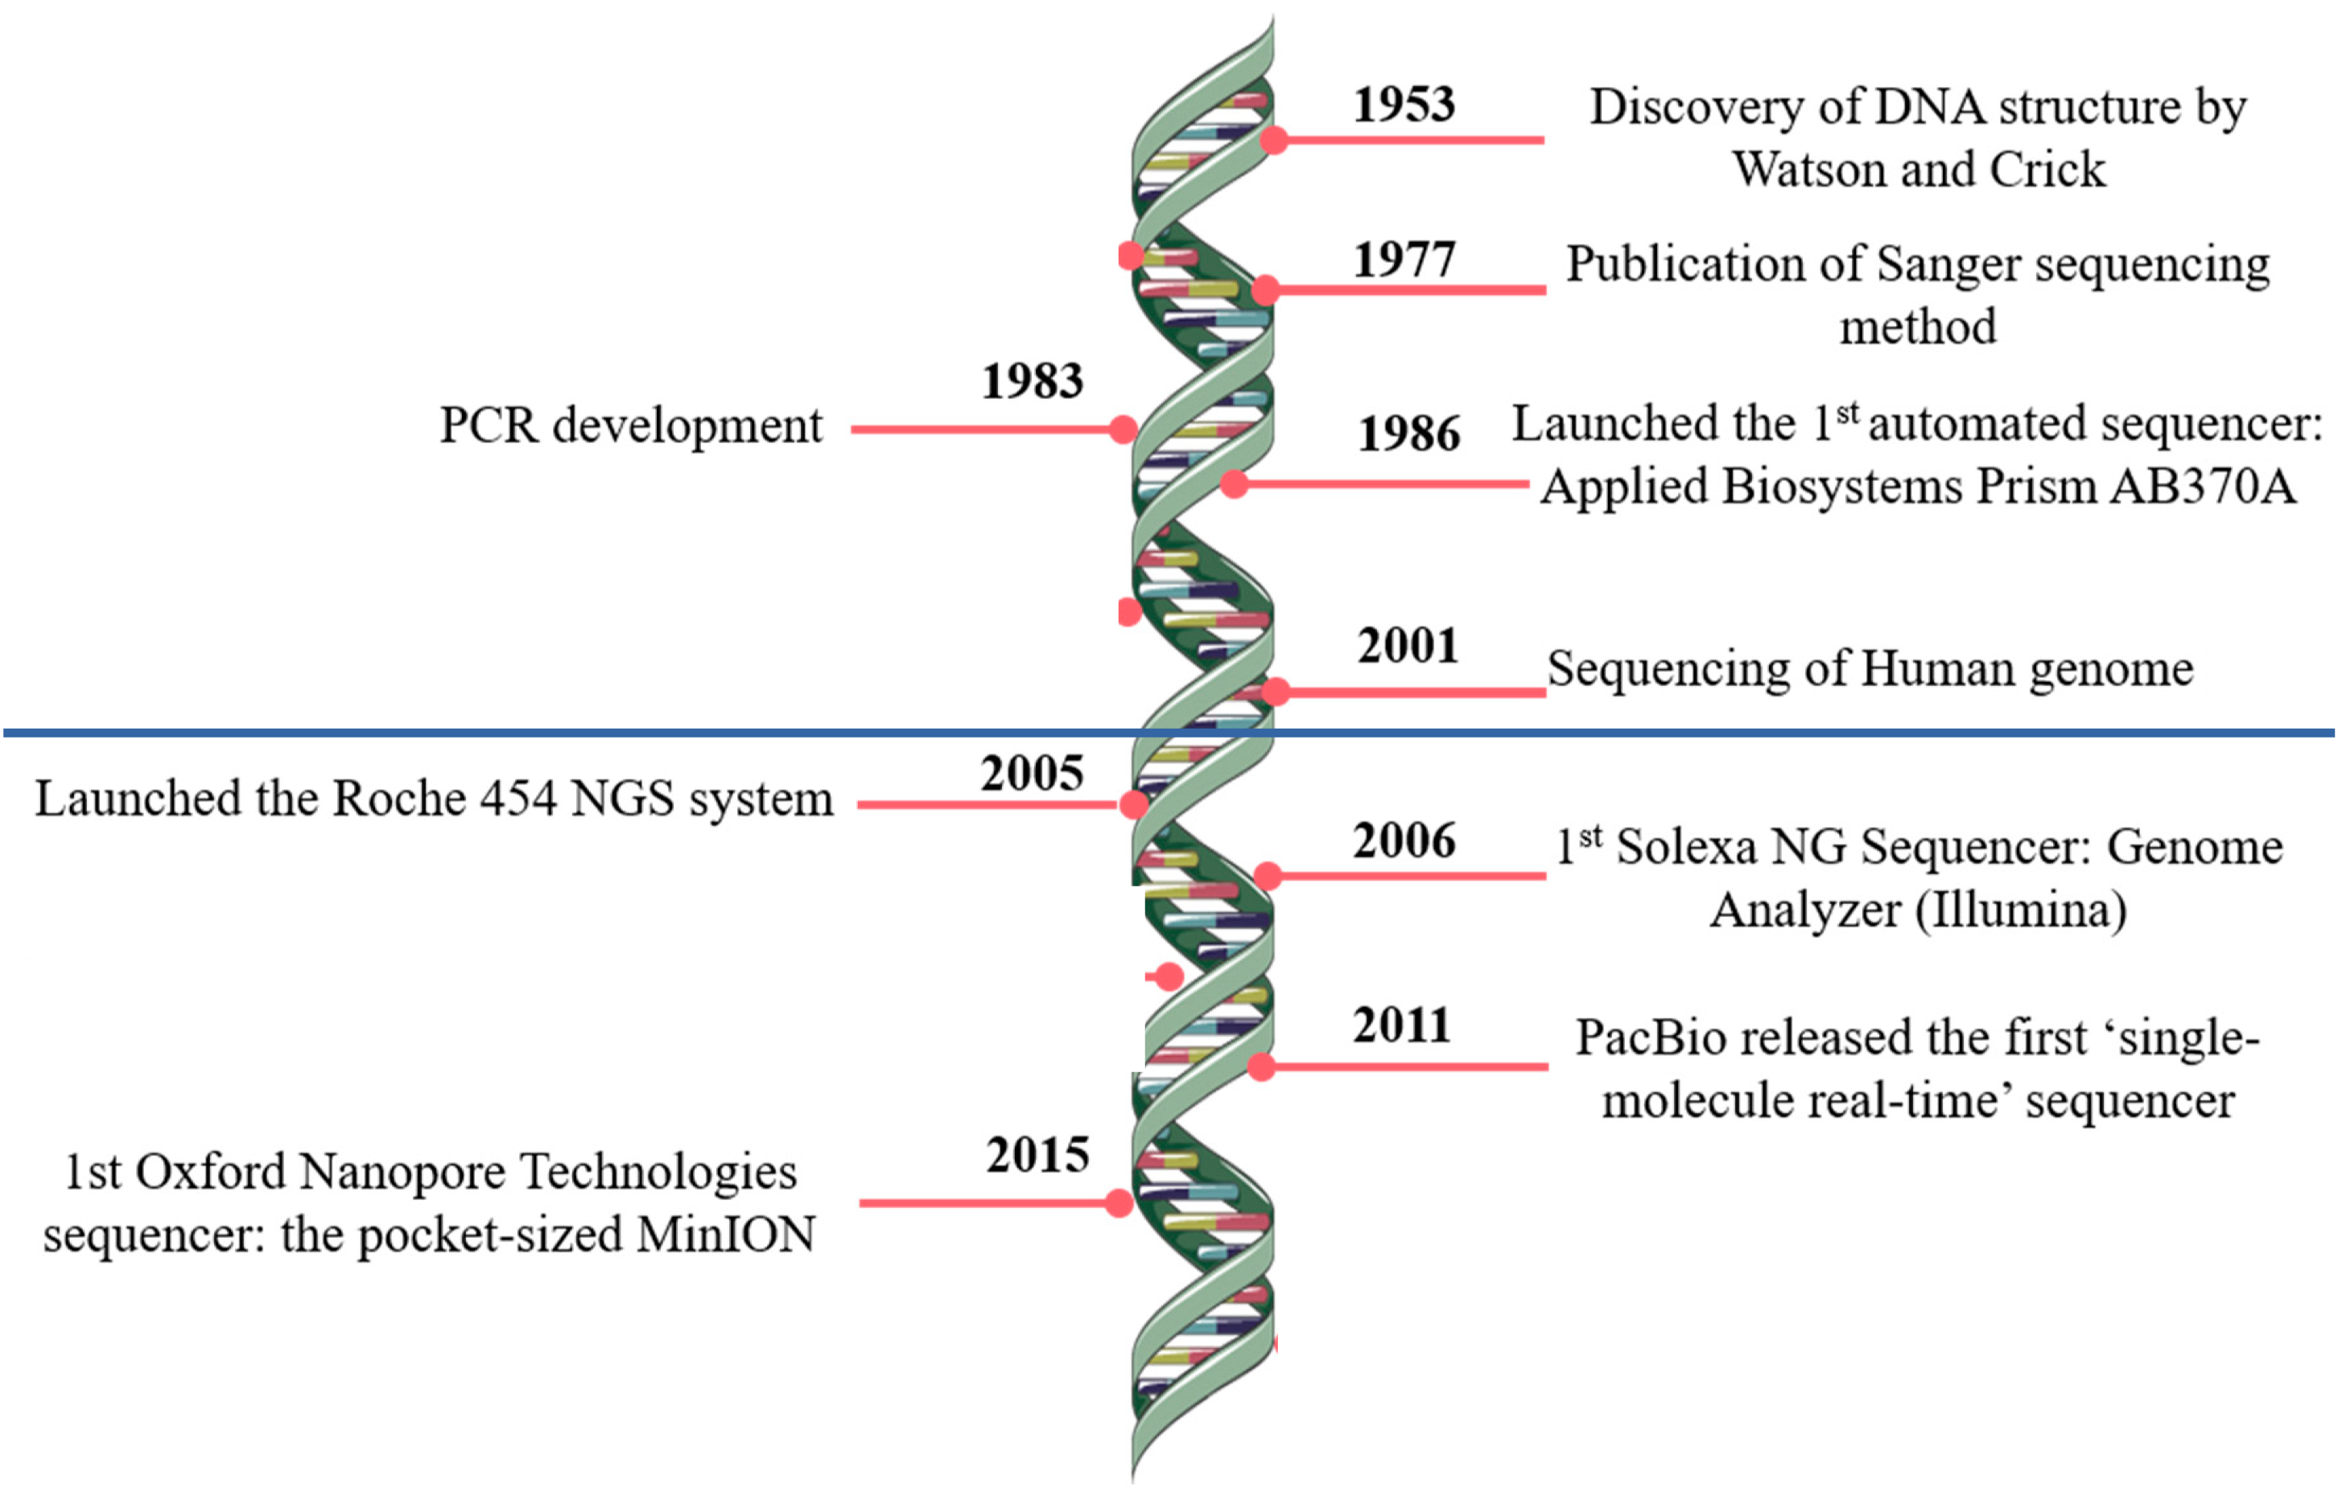

Slide 24
Indicate synthesis start site using sequencing primers
Allow for sample multiplexing using indices (barcodes)
Binding to the flowcell
PCR amplification of fragments

Slide 25
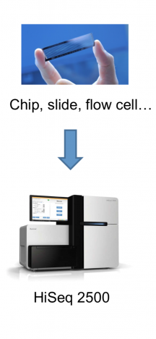

Slide 26
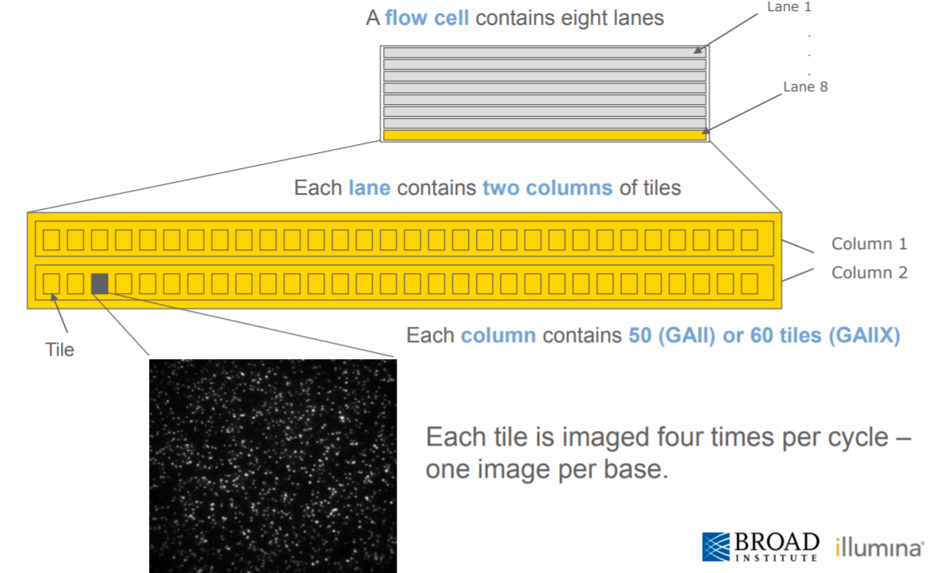
A flow cell contains multiple lanes
A lane contains multiple columns each with many tiles
Each speck in a tile is a cluster (!)

Slide 27
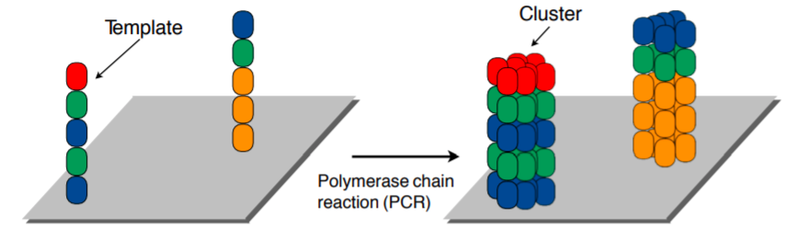
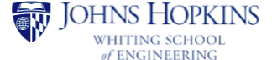

Slide 28
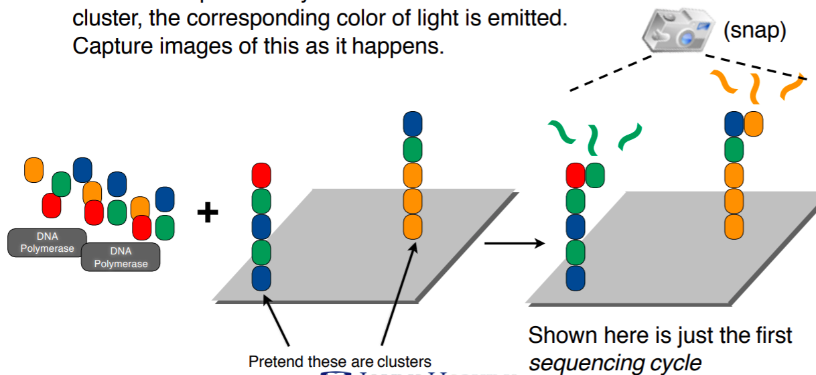
Add color-labeled nucleotides + DNA polymerase
When nucleotide is incorporated: light emitted & pictures taken

Slide 29
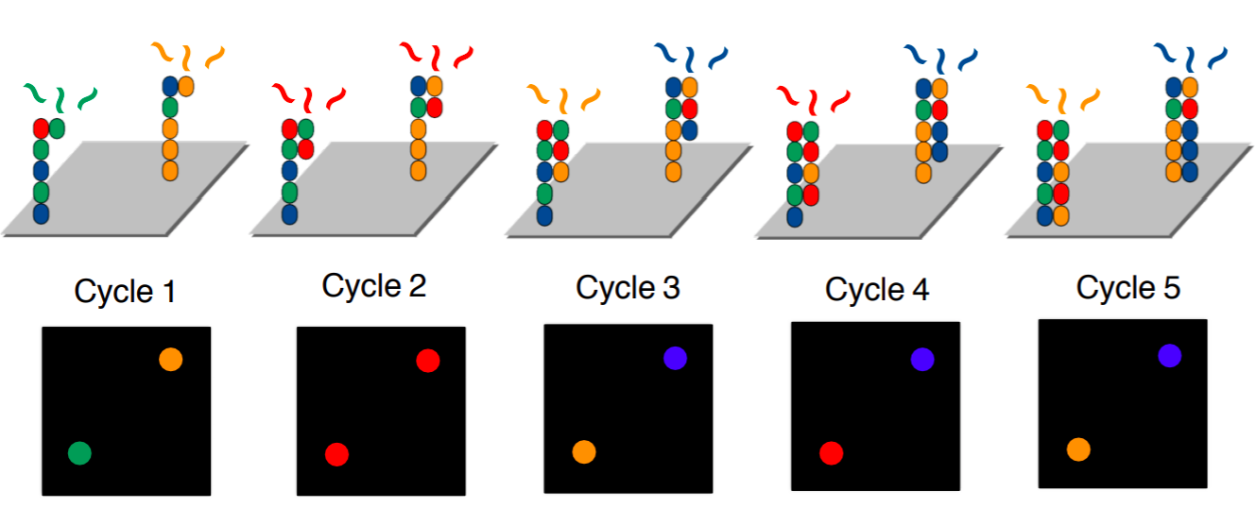
Terminators prevent continuous addition, hence “cycles”
- One cycle = one added nucleotide
- Read length = number of cycles

Slide 30
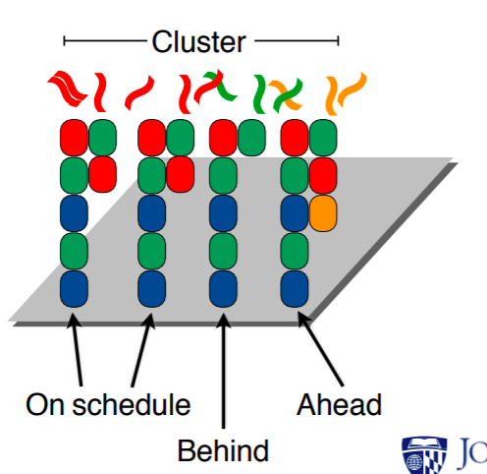

Slide 31
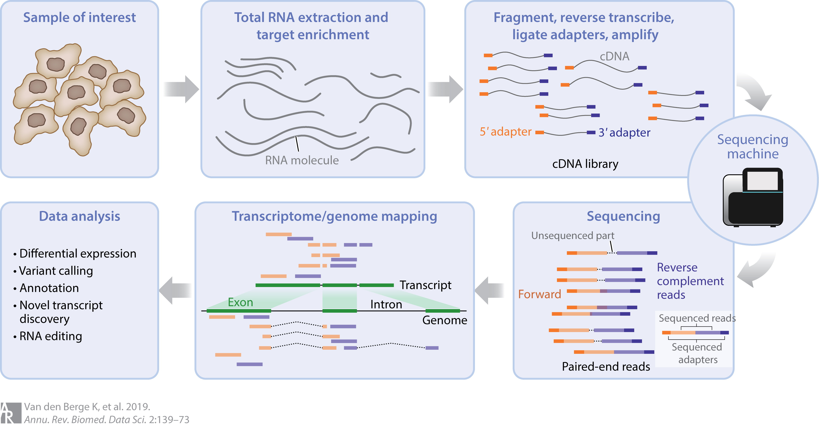

Slide 32
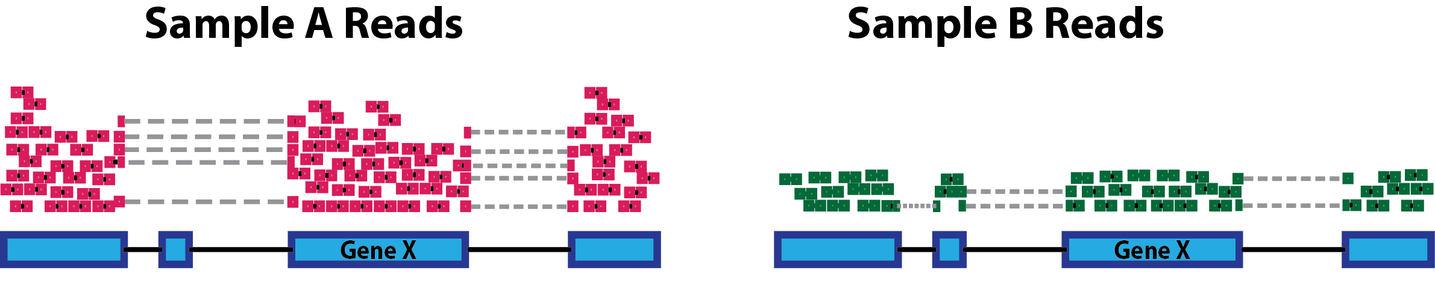

Slide 33
